Slide 1
Predicting 2025 GDP Growth with PySpark
Project Overview
Dataset Example
Leveraging historical GDP data from 2020-2024, this project aims to predict country-wise GDP growth for 2025. We employ a Linear Regression model trained using PySpark MLlib to forecast future economic trends.
Country
1999
2000
2001
2002
USA
3.08
2.90
3.09
3.0
Tech Stack
Libraries Used
Python 3.x: Core programming language
PySpark SQL: For data loading and manipulation
Apache Spark (PySpark): Distributed processing framework
PySpark MLlib: For machine learning model development (Linear Regression)
HDFS: Distributed file system for data storage
YARN: Cluster resource management
Key Outcome
The project delivers a robust forecast of 2025 GDP growth, with model evaluation based on RMSE.

Slide 2
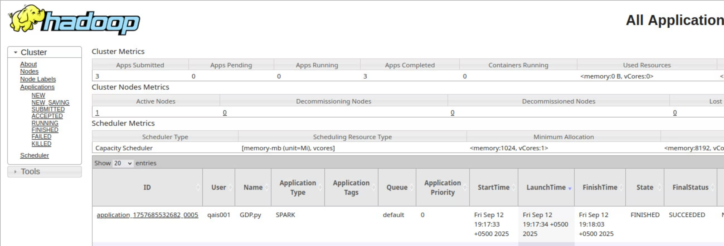
YARN

